Slide 1

ARDUINO I/O HARDWARE Compendium
(JusT)(Ask)
Notes:
Prepared for a MERG ARDUINO-SIG presentation that was delivered on May 17 2022.
Minor updates made to speaker notes post meeting.

Slide 2

Introduction
 | ARDUINO | Basics
Rev 2: Dec 2022 / AL / Added a page each on MOSFET and opto-MOSFET
Notes:
This is a overview of Arduino I/O hardware and various sensors or actuators.
It covers typical usage cases and also pros and cons of the various types.
As a ‘Compendium’ it does not go deep on any one subject but it should serve as an excellent overview of what is out there and give guidance where an Arduino user may want to dig deeper.

Slide 3


 | ARDUINO | Terminology
Input: A signal that come into the Arduino.
Output: A signal that the Arduino sends out.
Digital: The signal can be in one of two states (aka: binary).
Analog: The signal can vary over a range of values.
Note: We frequently say ‘the signal varies continuously over a range’ but inside the Arduino this is not correct.
An analog to digital circuit will change the analog signal into a numeric value with 10 bit resolution. (0-1023)
PWM: Pulse Width Modulation. A digital signal (in the form of a series of pulses) whereby the ratio of high to low time is altered to represent an analog range of values.
Sensor: A device that converts a physical property into an electrical signal that can be used as an input
Actuator: A device that converts an electrical signal into a physical property
I used this face to identify areas where I have had some personal (usually not good) experiences.
Notes:
Introduce basic terminology.
Re the sad face – The only person who never made a mistake – never actually did anything.

Slide 4
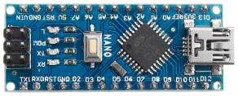
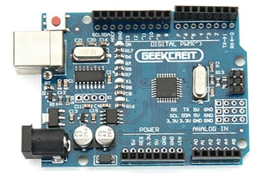
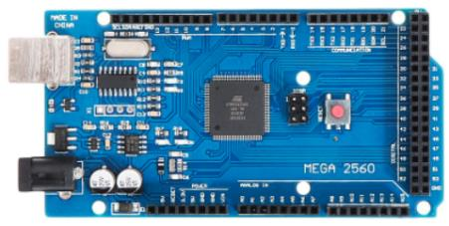
 | ARDUINO | Hardware
ARDUINO: Is not a single product but a range of products.
They are open source hardware and so ‘legal’ clones are available from a variety of manufacturers or from the OEM.
The commonality is they all use the Arduino IDE (Integrated Development Environment)
NANO / UNO / MEGA (and others) are names given to individual products in the Arduino family.
Simplistically they are small, medium and large … but differences can go a long way beyond this obvious aspect.
A lot of resources are available for specific boards. https://maker.pro/arduino/tutorial/a-comparison-of-popular-arduino-boards
Notes:
My preference is to start small (NANO) and let the requirements drive my projects.
Notes:
An overview of 3 types of Arduino.
Note there are many more than what is shown.

Slide 5
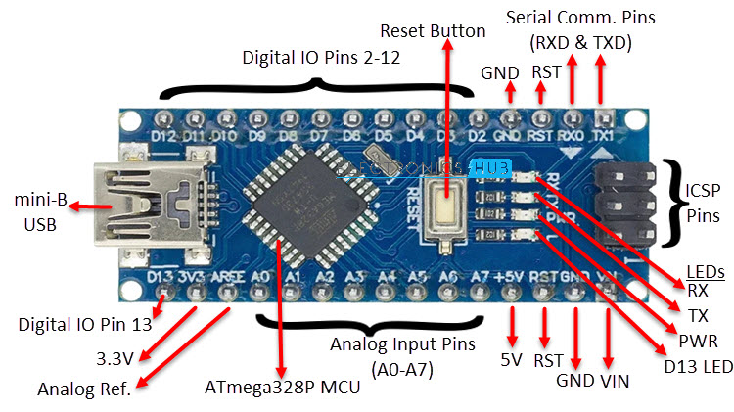
 | ARDUINO | NANO Overview
Notes:
Main message here – NANO is a very capable platform in a very small package.

Slide 6
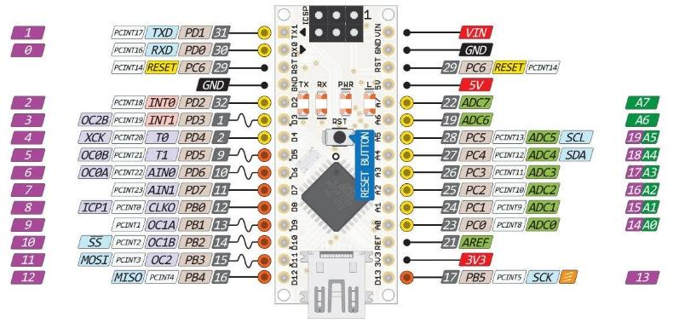
 | ARDUINO | NANO PINOUT
There are many diagrams like this one available on the internet. (Some are better than others).
I highly recommend you find one and print it out.
This is very handy to have around especially when creating your I/O listing (planning phase)
https://commons.wikimedia.org/wiki/File:Arduino-nano-pinout.png
Notes:
High level pinout diagram.
We will go into more detail on the pin groupings shortly.
Similar diagrams exist for other Arduino platforms – but we will focus on the NANO.
The capability of the others (pin vs pin) is similar but there may be more or less of those pins.

Slide 7
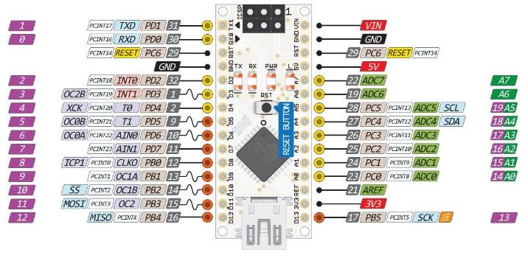
 | ARDUINO | PIN Descriptions (PWR)
Power and Voltage:
Vin – 7 to 12 VDC (supplies the on board 5V regulator)
GND – Ground (power supply reference) = 0 VDC
RST – Connect to ground via switch to reset the processor
5V – output from the 5V regulator. Also can supply power into the board here (This is after the regulator of course).
AREF – An external voltage reference for an analog input
(sets top of range). In my experience it is rarely used.
3v3 - output from the 3.3V regulator
Power Limitations
There are power limits for each pin, and the board as a whole. A common source of failure is exceeding these limits.
Abs Max per I/O pin = 40mA however recommended is < 20mA
Abs Max for all I/O pins together is 200mA however recommended is < 150mA
It is advised to review and consider power requirements for each project
Note that clones do come at much lower cost but may have less strict Q/C
Notes:
Power and Ground pins.
I Introduce the RST and AREF pin here – only because they have to go somewhere.

Slide 8

 | ARDUINO | PIN Descriptions (DI/DO)
Digital Pins
D0 – D13 Digital pins that can be Inputs or outputs
A voltage of +5 is read as ‘high’ (aka ‘on’ or ‘true’)
A voltage of 0V is read as ‘low’ (aka ‘off’ or ‘false’) (positive logic).
Depending on your wiring you may use negative logic where a 0V level actually turns something ‘ON’
You can use these pins interchangeably, however some pins do have alternate uses (stay tuned). Selecting the right pins gives future flexibility as your project evolves
Changing pins in software is quite easy.
If you are including your Arduino on a custom PCB selecting the wrong pin can be a bit of a problem
D13 is also special in that has an LED already built into it onboard. This is handy for doing simple tests.
In my experience NANO’s normally come factory programmed with the ‘blink’ program using D13
Notes:
Digitals. A lot of pins to choose from. Which one to use may depend on ‘the alternate uses for these pins’
I normally will keep some pins available just out of habit - because they have a lot of flexibility and designs do evolve over time
For example – D13 has a built in LED – very handy for quick and dirty troubleshooting
(example usage – turn LED on when entering a function, and off when leaving the function) – This way you will know if the function ever gets called.

Slide 9

 | ARDUINO | PIN Descriptions (AI)
Analog Pins
A0 – A7 Analog input pins
Normally a voltage of +5 is read as ‘1023’ and 0V is read as ‘0’
With a Vref on the AREF pin the ‘1023’ voltage can be changed.
Any voltage between these is converted to a number in between
Most of these pins can also be used as DIGITAL inputs or outputs.
A6 / A7 (not available on an UNO) are different in that the circuitry behind these pins lacks digital I/O capability and so lacks the pullup resistor. Be aware of this when using Analog pins in digital mode or with some components that may depend on the pullup to work. (LDR’s for example)
A4 / A5 are also different in that these pins have hardware support for I2C communications. If your project does not use I2C you can ignore this aspect and use them like any other analog pin.
Notes:
Analog Inputs
Just like D13 on the digitals here I like to keep A4/A5 available where possible – in case I2C might be needed.

Slide 10
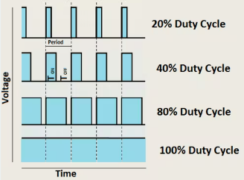
 | ARDUINO | PIN Descriptions (PWM)
PWM Pins
D3/D5/D6/D9/D10/D11 also have Pulse Width Modulation (PWM)
PWM can control brightness of an LED, control motor speed or even move a servo.
analogWrite( pin, value); // control brightness of an LED (0-255)
Use the <Servo.h> library to control up to 12 servos (error checking)
Most PWM pins repeat at 490 Hz but pins 5 and 6 work at 980 Hz
note: analogWrite lacks error checking when used on servos and you can over-rotate (strip gears) esp. on pins 5/6
Notes:
PWM – denoted by the little squiggly line on some of the pins.

Slide 11
 | ARDUINO | PIN Descriptions (coms)
Communication Pins
Several pins have hardware support for communication.
D0/D1 = Tx/Rx = Serial Transmit and Receive
D10/D11/D12/D13 = SS/MOSI/MISO/SCK = SPI Com’s
A4/A5 = SDA/SCL = I2C Com’s
Communication Pin Definitions
I2C
SDA = Serial Data
SCL = Serial Clock
SPI (old terminology)
MOSI = Master Out, Slave In
MISO = Master In, Slave Out
SS = Slave Select
SCK = Serial Clock
Serial
TxD = Transmit Data
RxD = Receive Data
Controller/Peripheral (NEW)
Controller In, Peripheral Out (CIPO)
Controller Out Peripheral In (COPI)
Chip Select Pin (CS)
Notes:
Communications. Note that for standalone applications running on a single Arduino these pins can be used as conventional I/O

Slide 12
 | ARDUINO | NANO PINOUT
Deep in the weeds here - Some labels we have not talked about
PORTS are banks of I/O on the microcontroller and for advanced programming the port can be important.
PORTS are designated B, C, and D.
Also notice the different colour circles indicating power groups.
Finally there are interrupts available on a lot of the pins.
Notes:
Deep down – Ports and Interrupts
Rounding off the things we have not yet talked about on our NANO Pinout MAP

Slide 13
Input Devices
 | ARDUINO | INPUTS
Notes:
A nano running the most sophisticated program in the world is not going to do too much if it does not have any I/O
Normally we would connect ‘Sensors’ to input pins (Analog or Digital)
We would connect ‘Actuators’ to output pins (again A or D)

Slide 14


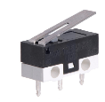
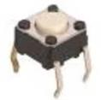
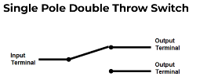
01 | On/Off Switch | Electromechanical
Usage: On / Off input Can be manually switched, or operated by a force. Can be ‘momentary’ (only switches while you press it) Or ‘maintained’ (you flip it and it stays in that condition) |  | Photos:
How it Works: Mechanical contacts. SPDT |  | Pros: Cheap and reliable Cons: Contact ‘bounce’ (software debouncing is common) (Arduino is fast enough to pick up bouncing contacts) Wear and tear
Notes: Contact voltage or current rating is rarely an issue for switches used in signaling. These ratings are very much an issue when switching power circuits.
Notes:
Starting off with a simple switch – the page sets the pattern for all the other I/O devices to be covered.
Note diagram on electrical contacts. This diagram applies to a switch where our finger moves the contact over
But it also applies to a relay – where an electromagnet moves the contact over.
Other common arrangements include DPDT (Double Pole – Double Throw)
(two independent common terminals (the Poles) and each pole feedings two output terminals (Double Throw).
Note that changeover of both poles happens at same time
4PDT comes up from time to time – for switching a DCC programming track.

Slide 15
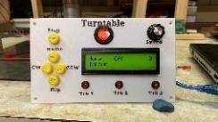
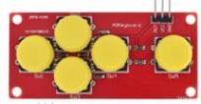
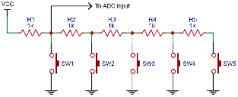
02 | Switch Module | Electromechanical
Usage: Multiple On / Off switches on one analog input |  | Photos:
How it Works: Mechanical contacts switch in and out various resistors which give a unique value for the analog input. |  | Pros: Several inputs on just one analog pin Cons: Size and button pattern fixed for the module Some experimentation to determine what analog value maps to what button push.
Notes: The circuit behind the buttons is called a resistor ladder. You can build your own resistor ladder using standalone switches and resistors. Circuit shown is simple (same R) ( Better designs will use different values of R)
Notes:
In between a simple switch and full on sensor this little module can save a lot of pins.
The ladder schematic shown is a simple one to get the idea across.
It could easily be built from external components and use any number of buttons.
The Red module has a more sophisticated ladder (different R values and arranged differently)

Slide 16


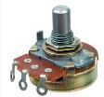
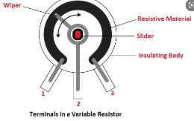
03 | Variable Resistor | Resistance
Usage: Volume Control Speed Control Changing a ‘Trigger Point’ |  | Photo:
How it Works: Turning the knob causes a wiper to slide over some resistive material. Electrically the two end points and the wiper are brought out to pins. |  | Pros: Cheap and reliable Cons: Electrically can be ‘noisy’ as the contact moves
Notes: Different resistor values are available to suit the application. Also the resistance may vary linear with rotation or logarithmically (common in audio applications) Multi-turn, single turn, linear are also options |  | Also known as a ‘potentiometer’ ( or pot for short)

Slide 17

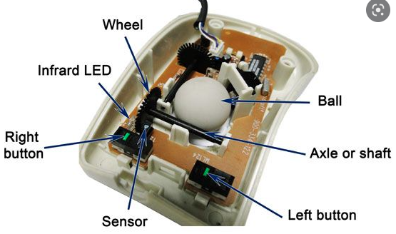
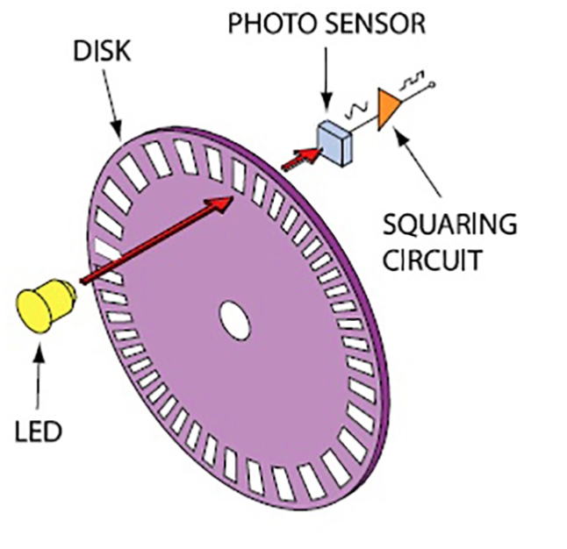
04 | Optical Encoder | Angular position
Usage: Speed (of Rotation) Determining Absolute position |  | Photo:
How it Works: Turning the wheel causes a light beam to be interrupted thus generating a series of digital pulses. By arranging different light sources and holes on the disk absolute Position can be determined. |  | Pros: Accurate and relatively immune to noise Absolute or incremental position depending on wheel and number of light sensors. Cons: Requires relatively fast processing the digital signals
Notes: Different encoder wheels are available to suit the application. (accuracy, absolute position or incremental)

Slide 18
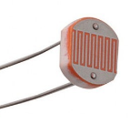
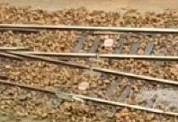
06 | Sensor (LDR) | Light Dependent Resistor
Usage: Occupancy sensor at a specific place. |  | Photo:
How it Works: A resistor whose value changes depending on light falling on it. (Can detect the shadow of a train passing over.) |  | Pros: Very inexpensive Small and easily disguised between the rails Cons: Sensitive to ambient light. (solutions are available)
Notes: Connect between an analog input pin and ground Enable the internal pullup resistor (in software) The LDR forms a ‘voltage divider’ and with some testing the ‘light vs dark’ cases can easily be distinguished. |  | Note #2: In the Arduino IDE the use of the serial plotter was invaluable in my experimenting with LDR’s.
Notes:
My demonstration layout uses two sets of three LDR’s.
Each set of three is smoothed, then averaged. If any single value differs from the average it’s digital value is triggered. Before acting on those digitals I also used debounce logic.
Ran flawlessly over a two day show triggering sound effects and also a mimic panel.

Slide 19
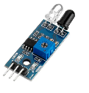
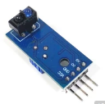
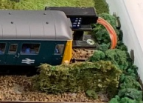
07 | Sensor (IR) | Infrared Light
Usage: Occupancy sensor at a specific place. |  | Photo:
How it Works: Infrared light is sent out and if a reflection is seen the sensor output is turned on. Sensitivity can be adjusted. |  | Pros: Cheap and reliable. Relatively immune to ambient light 3 pin = DO only, 4 Pin has DO and AO outputs Cons: Module size and pinout varies by manufacturer Can be affected by sunlight
Notes: Different geometries available. (end on, 90 degree) Be aware that pin outs do vary by manufacturer Two modules facing each other can interfere

Slide 20
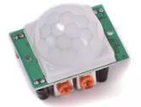
08 | Sensor (Passive IR) | Infrared Light
Usage: Detects heat and toggles an input on or off when something in range is detected. A typical application is to automatically do something when someone enters a room or approaches. |  | Photo:
How it Works: Detects heat and toggles on or off when something is detected. The sensitivity can be adjusted. |  | Pros: Inexpensive and reliable Works over longer distances Cons: Physically large Anything that gives off heat can toggle it
Notes: Does not depend on visible light. A common application at home is to turn on security lights when someone approaches at night.

Slide 21
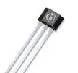
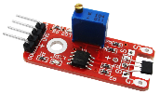
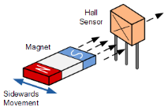
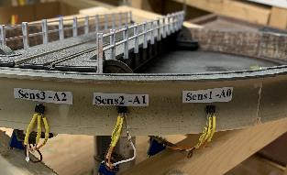
09 | Sensor (Hall Effect) | Magnetism
Usage: Detect Magnetism at a specific place. |  | Photo:
How it Works: A magnetic field activates the sensor output |  | Pros: Cheap and reliable. Works ‘through’ some materials. Using ‘edge detection’ it is very repeatable. Cons: Hysteresis (trip point is sensitive to direction) Needs a rare earth magnet for max sensitivity
Notes: Module produces both an analog and a digital output. Sensitivity is adjustable Due to the Hysteresis I do edge detection always travelling in the same direction Be Aware: Hall effect sensors can be latching or momentary (select the right one for your application)

Slide 22
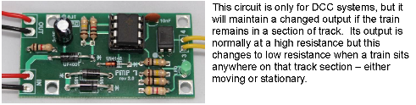
08 | Sensor (Current) | Electrical Current
Usage: Occupancy sensor for a block of track. Detecting when a train (especially a locomotive) is drawing electrical current on a block of track. |  | Photo:
How it Works: A small electronic circuit monitors the current supplied to an isolated section of track. It turns on an output if current is detected. |  | Pros: Cheap and reliable Unlike a ‘point detector’ which works at one physical spot only this is a ‘block detector’ and anything drawing current in the block is detected. Cons: If what is on the track does not draw current (eg coaches and wagons) they wont be detected.
Notes: Known as a Train on Track Indicator (TOTI) MERG PMK7 is this example. Others are available. Shown is DCC but also available for DC traction power. |  | A workaround for wagons and coaches is to add a 10k SMD resistor to the axle between metal wheels then conductive paint to connect the resistor ends to the wheel. (from McKinley railway YouTube channel)

Slide 23
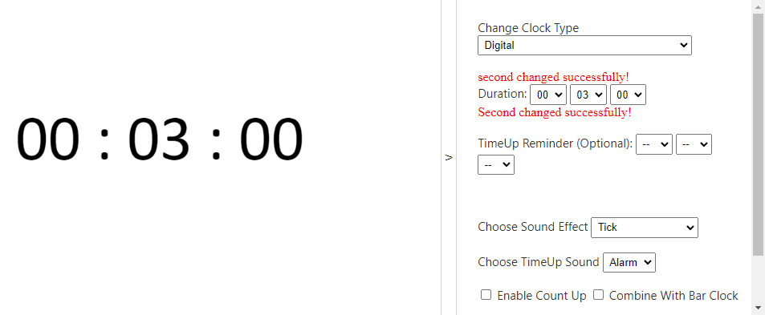
Time for a brief intermission.

Slide 24
Simple Output Devices
 | ARDUINO | OUTPUTS

Slide 25
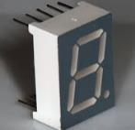
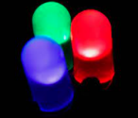

10 | LED | Light Indication
Usage: Area lighting Status indication – feedback on operation Animation effects |  | Photo:
How it Works: Applying a small forward voltage (in the conducting direction of a diode) causes current to flow. The amount of current is normally limited by a series resistor. This current causes the LED to give off light. |  | Pros: Many physical sizes and shapes Many colours available Very efficient light (not much heat generated) Switches on and off very fast
Notes: Applying a forward voltage without current limiting will most likely destroy an LED. |  | Although they are a diode they are not a power diode. The reverse voltage rating is quite low. (spec sheet) Try not to hook them up backwards if voltage > 5VDC !

Slide 26
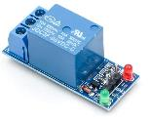
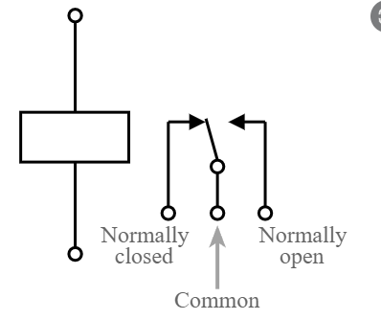
11 | Relay | Electromechanical
Usage: Low power output from Arduino Pin can control a higher power electrical circuit. |  | Photo:
How it Works: A low power digital signal causes a magnetic coil to energize which pulls together electrical contacts for use on a higher power circuit. |  | Pros: Inexpensive Allows switching electrical loads beyond the rating of an Arduino alone. Cons: Physically large Produces an audible click when it changes over
Notes: Wear and tear depends very much on frequency of operation and how much heat the coil is subject to. If the contacts are switching significant currents (100ma+) be aware that the contacts can actually weld together. (read the data sheet for any non-trivial application) |  | As far as the relay is concerned the coil is its input and the contacts are its output. Use extreme caution if switching higher (ie mains) voltages.
Notes:
Relays come in all sizes and configurations.
For Arduino applications check to ensure a reverse bias diode is installed across the relay coil.
(for modules designed and sold for Arduinos the diode is commonly built right into the module)
Why: When you switch off a coil the magnetic field collapses quickly .. This sudden collapse generates
a voltage in the coil which could easily exceed the rating of the Arduino.
The diode safely shunts the current and so only small voltages are generated.

Slide 27
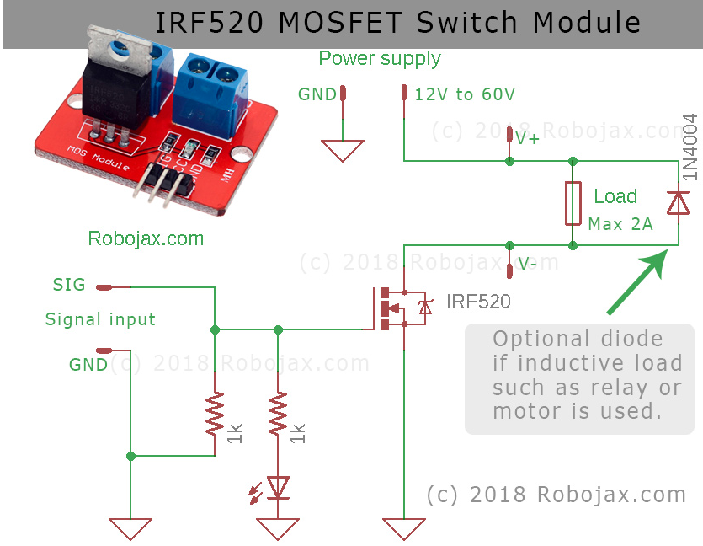
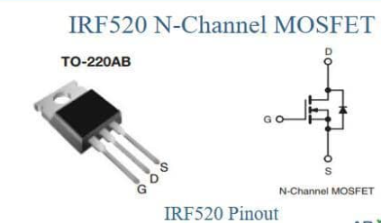
11b | MOSFET | Electronic Switch
Usage: Low power output from Arduino Pin can control a higher power electrical circuit. It is essentially a relay replacement. |  | Photo:
How it Works: A low power digital voltage signal is applied to the gate of the device. This allows a higher current to flow from the source to the drain. |  | Pros: Inexpensive Allows switching electrical loads beyond the rating of an Arduino alone. Cons: Not all devices are rated for logic level switching voltage High input resistance can make them static sensitive
Notes: Unlike a relay wear and tear is negligible. A barebones MOSFET is a large 3 pin transistor. Good discussion here: https://www.youtube.com/watch?v=GrvvkYTW_0k and here: https://forum.hobbycomponents.com/viewtopic.php?f=76&t=1872 Good Review of Data sheet here: https://www.youtube.com/watch?v=oEBS7kAJz6U |  | Electrical and thermal limits are very important. The latter is often constraining. (A MOSFET can carry a lot of current but only if you can get rid of the heat). Power (heat) = I² R The I is your current. I² (I squared) is just I times itself. The R here is the ‘on resistance’ of the device.
Notes:
MOSFETS come in all sizes and configurations.
For inductive loads check to ensure a reverse bias diode (kickback diode) is installed across the relay coil.
Why: When you switch off a coil the magnetic field collapses quickly .. This sudden collapse generates
a voltage in the coil which could easily exceed the rating of the Arduino.

Slide 28
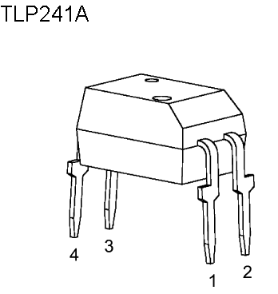
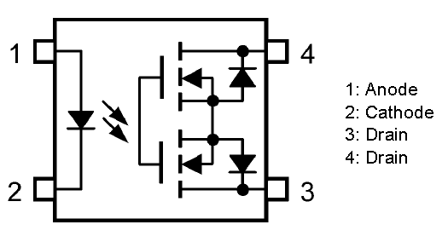
11c | Opto-MOSFET | Electronic Switch
Usage: Low power output from Arduino Pin can control a higher power electrical circuit. It is essentially a relay replacement.
How it Works: A low power digital voltage signal is applied to a fully enclosed LED. The led activates the gate of two back to back MOSFETs in the same package. This means current can flow in either direction. Effectively you light an LED and the LED turns something else on. |  | Pros: Inexpensive Allows switching electrical loads beyond the rating of an Arduino alone.
Notes: Unlike a relay wear and tear is negligible. The use of opto-coupling means the input circuit and the output circuit need not have anything in common.
Notes:
MOSFETS come in all sizes and configurations.
For inductive loads check to ensure a reverse bias diode (kickback diode) is installed across the relay coil.
Why: When you switch off a coil the magnetic field collapses quickly .. This sudden collapse generates
a voltage in the coil which could easily exceed the rating of the Arduino.

Slide 29
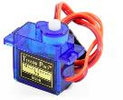
12 | SERVO | Mechanical Motion
Usage: Operating points (turnouts). (Use it as a point motor) Semaphore signals (including bounce effects) Animation effects (crossing gates, swings, opening doors) |  | Photo:
How it Works: On board electronics convert a pulsed output signal into an angular position and rotates the shaft accordingly. 0.5ms pulse = 0 degrees, 1.5ms pulse = centered 2.5ms pulse = 180 deg (typical) Be aware – similar looking servos can be different! |  | Pros: Inexpensive Simple 3 Wire Operation Cons: Usually requires a bracket for mounting. Usually requires ‘calibrating’ for desired range of motion
Notes: Various size arms attach to the shaft. Each arm has several holes into which you can put a wire. An ‘omega loop’ is a good idea for strain relief. Only the time spent high is important. Use the <Servo.h> library – it has built in error checking. Be Aware: Analog servos and digital servos behave differently. Both work off the same pulse signal input. |  | MERG video on Servos: https://www.youtube.com/watch?v=uY_M6kJRuUo&t=425s Another explanation of how a Servo works on the inside: https://www.youtube.com/watch?v=xB_4KB72res&t=309s Trivia : 9g refers to the weight in grams!

Slide 30
More Sophisticated I/O Devices
 | ARDUINO | I/O

Slide 31

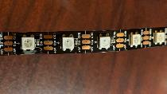
14 | Addressable LED | Lights with smarts.
Usage: A string of LED's where each element can be addressed uniquely. Each light is individually controlled for colour and brightness. Great for animation effects, control panels. |  | Photo:
How it Works: Each 'pixel' consists of three LED's (one green, one red, one blue). Additionally a small microprocessor (in each pixel) is listening for commands and passing them on. Only commands for that pixel are acted on. |  | Pros: Control a large number of LED’s Uses only one data pin. Huge variety of colours and effects are possible. (with software control) Can be cut across the copper pads at any length.
Notes: Don’t overload the 5 volt regulator on a NANO for example.

Slide 32
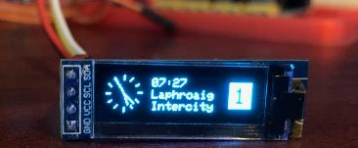
15 | OLED Display | Organic Light Emitting Diode
Usage: Very small pixel allows them to be made in arrays and used as a display for arbitrary shapes (including fonts) |  | Photo:
How it Works: An array (132 x 32 shown) of individual OLED dots plus some on board smarts allow messages to be sent and displayed. |  | Pros: Cheap and reliable. Multiple units can butt against each other Cons: No ability to change colours (Can be bought with different colours)
Notes: Uses I2C communications – 4 wires including power In software it is essentially: 1) Set the cursor location and 2) Print (text) or draw (lines) |  | Another common size is 132 x 64

Slide 33

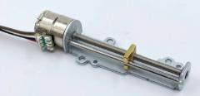
16 | Linear Motor | Mechanical Motion
Usage: Positioning Animation - moving things in a straight line |  | Photo:
How it Works: A stepper motor rotates a drive screw which pushes a captive nut back and forth along a track. |  | Pros: Small and inexpensive (above left - no on board electronics) Cons: Small and very expensive (above right direct rotary replacement)
Notes: Stepper motors normally use a motor shield. With motor shields large stepper motors are possible (very powerful / lots of torque)

Slide 34
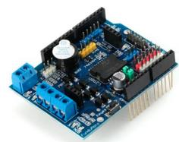
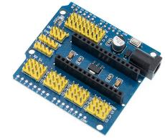
17 | ARDUINO | Shields
Shields
An important part of the Arduino environment is the ability to add boards called shields.
These simply plug onto the Arduino (UNO and MEGA) and in doing so expand its capability.
For a NANO typically it is the NANO that plugs into the board but the concept is the same.
The pins of the Arduino are carried to the shield and allow the shield to interact with the Arduino without a lot of additional wires.
Shields often includes additional functionality and sometimes the simplest part is the most useful
such as providing lots of +5V and Ground connection points and 3 pin headers.

Slide 35
(Backup) (SLIdEs)

Slide 36
 | ARDUINO | I/O Planning
Notes
Well planned Arduino projects begin with a good input/output list (I/O list).
This is not difficult but will greatly aid your project development including:
Selecting the right sensors and actuators
Picking the right platform (Arduino)
Making the right pin assignments
Logical approach to program (sketch) development
Naming your variables according to a plan)
Where to break down a sketch into reusable parts (functions, structures, or classes as appropriate)
Identifying ‘risk’ – areas where more research or testing may be needed
A good I/O List includes:
Which Arduino are you working on (if your project has multiple arduinos)
A signal name, an I/O designation, a pin number, and a brief (one or two words) statement of intent
Over time the I/O list can be expanded to include (for example) a sensor type, a JMRI/CMRI designation

Slide 37
 | ARDUINO | I/O Planning
Example I/O list: (In this plan Inputs and Outputs are distinguished by colour)
Name Description Arduino Pin CMRI‘Sensor’ Notes
----- --------------------- ------- --- ----------- -----
PM2T Thrown Status 2 A4 CS1 Closed Status is inverse
IR02 End of siding #2 2 A2 CS3
TOTI2 Siding #2 2 A1 CS5
Name Description Arduino Pin CMRI‘Light’ Notes
----- ---------------------- ------- --- ----------- ----
Rly1 Activate Random Relay 6 A0 CL4001 MERG Kit
Rly2 Activate Welding Relay 6 A1 CL4002 MERG Kit
Msg1 Change message Index 6 A4/A5 CL4003 I2C OLED

Slide 38

 | ARDUINO | Pull Up Resistor
Equivalent Circuit
3 Pin Header
Arduino Digital Input
+5 VDC
+5 VDC
Internal Pullup R
Internal Pullup R
DI Signal
Switch
DI Signal
Gnd
Gnd
How it works:
Some Arduino inputs can have an internal resistor called a pull up resistor. (enabled via software)
With nothing else connected (switch is open) this resistor connects the input to the 5 volt level which the input sees. (Since current flow is zero the voltage drop across the resistor is also zero. ( using ohms law of V = IR)
If the switch is closed the input is connected directly to ground and now the input sees that new value
The pullup resistor value is high enough that current flow from 5VDC to ground through the switch is negligible.
An ‘external’ pullup resistor could be used equally well.
Sometimes a ‘pulldown’ resistor is used but never would you use both at the same time.
Notes:
The pullup resistor tends to make the DI pin go up to 5 volts as long as the switch is ‘open circuit’ as shown.
If the switch is closed the DI signal is connected to ground.
With no pull up resistor and the switch open circuit the DI signal is said to be ‘floating’ and the voltage (and consequently I/O reading) can be quite random.

Slide 39
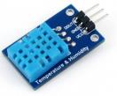
 | Sensor (Temp) | Temperature and RH
Usage: Ambient temperature (and Humidity if using a DHT sensor) Included for completeness – (I am not aware of a model railway application.) |  | Photo: DHT11 Module
How it Works: A thermistor (resistance varies with temperature) feeds an onboard chip that converts this to temperature. Humidity is measured by measuring the resistance between two electrodes in air. |  | Pros: Inexpensive and quite accurate Cons: Narrow operating range (geared to typical ambient values)
Notes: The chip calculates relative humidity All readings are sent via serial communication DHT devices are well supported in the Arduino library Be aware of differing pinouts Thermistor <> Thermocouple |  | Link for More Info: https://create.arduino.cc/projecthub/pibots555/how-to-connect-dht11-sensor-with-arduino-uno-f4d239
Notes:
During presentation it was mentioned this type of sensor could be used for ambient monitoring.
The current ambient conditions can be used to improve accuracy of ultrasonic range finders (speed of sound in air varies according to temperature and humidity)

Slide 40
 | At a Glance | Arduino Communications
Simple Serial Asynchronous Point to Point Slow Short distances only |  | RS485 Asynchronous Multidrop Relatively Slow (19.2 Kbps) Long distances Has no specified protocol so this must be created (layered on top)
I2C Synchronous Two bidirectional lines (data + Clock) Multi-drop and Multi-master Performant (5Mhz) Short to Medium distances |  | CAN Multidrop Moderately Performant (1Mhz) Distance is not a practical issue. Used as the Layout Control Bus on many MERG kits.
SPI Synchronous (2 Wire + Clock) Multi drop (but not multi-master) Very Performant Short to Medium distances
Some material on this and the following slides was extracted with permission from a forum posting by ElectricDave:
https://www.merg.org.uk/forum/viewtopic.php?p=172961#p172961

Slide 41

 | Simple Serial | Serial Communications
Usage: Relatively slow point to point communications over short distances. |  | Photo:
How it Works: TxD Transmit is digital pin 1 , RxD Receive is pin 0. Using the <Serial.h> library we use simple commands like Print() to send messages out to the serial pins. The library sends the bytes that make up the message out the TxD pin in the form of a series of data frames. Each frame (corresponding to one byte of data) has a start bit, data bits, a parity bit and stop bits. |  | Pros: Proven in use. All Arduinos have Tx/Rx pins. Cons: Point to point communications only. Relatively slow. Only the most basic error checking (and only if parity is enabled), no built in retry, or any form of guaranteed delivery.
Notes: Some common terms associated with serial comms BPS = Bits per Second i.e. the speed of communications. Higher is faster. Technically not the same as the Baud rate although (the number of state changes on the wire) but the two terms are often used interchangeably. Parity is a single bit added to the frame which can be either 1 or 0. It is used to make the total number of 1’s in the frame either Odd, or Even. Stop bits indicate the end of the frame. 9600 8N1 is a shorthand notation for 9600 bps, 8 data bits, No parity and 1 stop bit. |  | UART – Universal asynchronous Receiver/Transmitter. Takes a byte (8 bits) as input and shuffles the data bits out serially at a specific BPS while automatically adding the start, stop and parity bits as may have been configured. RS-232 is an old serial standard that use to be very common. It operates on +/- 12 volt signals. The physical connector for RS-232 had a 25 pin plug/socket (later 9 pins). (DO NOT connect RS-232 signals directly to Tx/Rx or bad things will happen!)

Slide 42
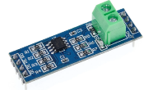

 | RS-485 | Serial Communications
Usage: Relatively slow long distance communications in electrically noisy environments. Layers itself on top of simple serial. Unlike simple serial this can be multi drop. |  | Photo:
How it Works: Individual devices (nodes) are given an address and only respond to messages addressed to them. Signal is via voltage difference on two unshielded wires. Any electrical noise is picked up equally on both wires - and thus cancel out (no difference). |  | Pros: Old school and reliable. Forgiving of less than ideal wiring practices. (Was) commonly used in industry for PLC's and robotics as the underlying transport for 'Modbus’. Cons: Relatively slow. Extra hardware for distances. Be aware of termination resistors (too many or not enough)
Notes: RS485 has no defined transmission protocol. This must be added/layered on top/ or created. My display layout has 5 RS485 modules plus a USB interface. RS485 modules have built in termination resistor R7 which must be removed from each intermediate module (i.e. not the last one) on a network. |  | One node (called the master) can initiate communications while all other nodes (called slaves) can only respond. If you are JMRI user then the CMRI subsystem makes using RS-485 very simple as it implements the transmission protocol and the complexity is all hidden.

Slide 43


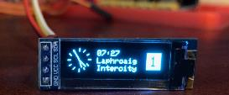
 | I2C | Serial Communications
Usage: A multi master bus with good speed ( 5Mhz) over short distances. Since the clock signal is generated the speed can be variable. Lower speeds yield longer distances. Good for most model railway distances. |  | Photo:
How it Works: SDA is bidirectional serial data, SCL is a bidirectional serial clock. Messages sent to specific addresses. (A print statement in software). The software library function handles all the details. I2C is a network that has been proven in use at 10’s of meters (which is far beyond its design intent < 1 m) |  | Pros: Fast and easy to implement Well supported in the market Arduino has built in support (A4 = SDA, A5 = SCL) Many IC’s have I2C support built in. (Temperature sensors, EEPROM, display modules) Cons: SDA and SCL need pullup resistors (Arduino pullup is ok)
Notes: Two applications on my own layouts OLED station board (right) Turntable Control Panel LCD User Interface Be aware: Addresses are often fixed at factory (can’t change)

Slide 44
 | SPI | Serial Communications
SPI = Serial Peripheral Interconnect A synchronous multi-drop communication protocol. (not multi-master) |  | Note: The terminology for SPI is in transition.
SPI offers the best functionality for closely coupled applications. |  | Pros: Significantly more performance than other protocols. No addressing except by hardware (using chip select) Cons: Requires chip select logic if you have multiple peripherals.
Built in support is present on most controllers and makes the implementation task quite simple however (according to Arduino) the difficult part about SPI is that the standard is loose and each device implements it a little differently. This means you have to pay special attention to the datasheet of your peripheral.
Master/Slave (OLD) | Controller/Peripheral (NEW)
Master In Slave Out (MISO) | Controller In, Peripheral Out (CIPO)
Master Out Slave In (MOSI) | Controller Out Peripheral In (COPI)
Slave Select pin (SS) | Chip Select Pin (CS)

Slide 45
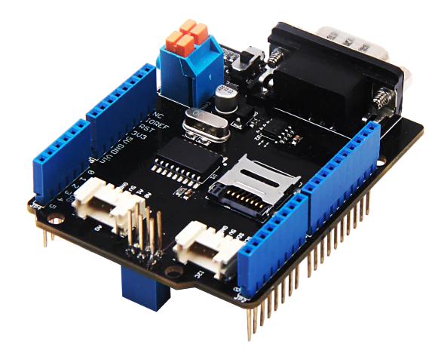
 | CAN | Serial Communications
CAN: is an asynchronous multidrop communication protocol. It was designed for applications that are not closely coupled. (i.e. they work more or less independently) |  | Photo:
Uses a D9 serial connector (as with legacy serial) Not all pins are defined or used. 3 wires are the minimum (CANL, CANH, GND) with optional Power and Shield pins. |  | Pros: Multidrop Moderately Performant (1Mhz) Distance is not a practical issue. Cons: Requires a shield (external hardware) for use on Arduinos
 |  | Used as The Layout Control Bus on many MERG kits.

Slide 46
(ThE) (ENd)
Notes:
Only very minor updates made post presentation. (mostly to speaker notes)

